Slide 1
SQL in-class activity: Create Cohort Table
- Paul Chien -

Slide 2

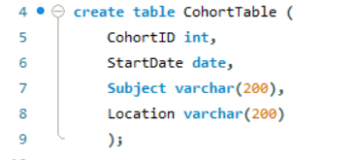
Name of database
- Creation of database
- Entering into created database
Name of table
- Creating table within database
- Corresponding datatype for each field
Name of the 4 columns/fields

Slide 3
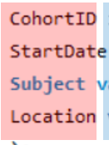

Name of table
- Insertion of row/record into the database one at a time

Slide 4
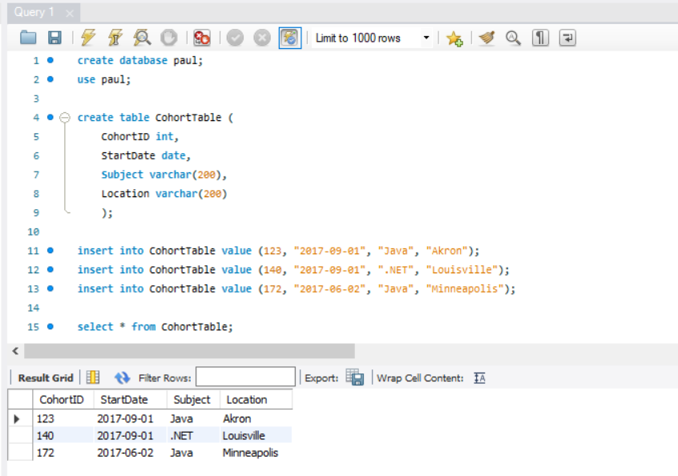
Click to execute all commands
To query all records (*) in the table

Slide 5
Thank you
Any questions?

